Slide 1
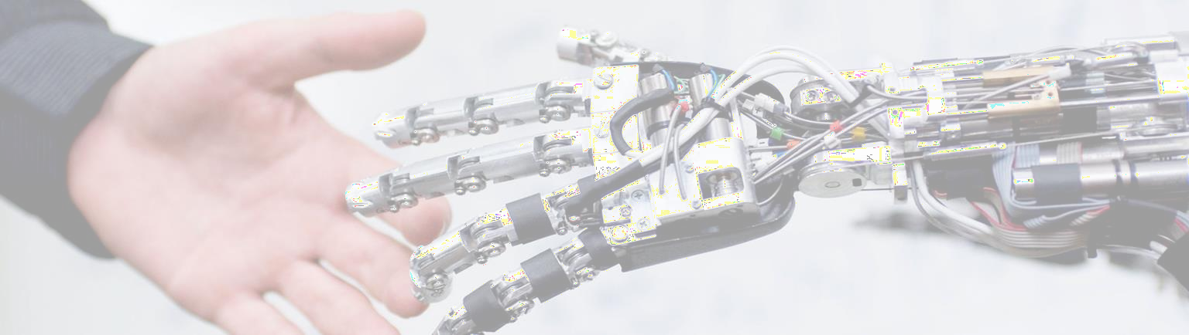
Machine Learning for Robotics
Week # 13: Support Vector Machine (SVM)
Dr. Maryam Iqbal

Slide 2
About Instructor
PhD EE (Controls, Automation & Rehabilitation Robotics)
Research areas: Robotics & Automation, Artificial Intelligence, Machine Learning, Biomechanics, AI in Healthcare
In charge : BSRIS Program at Bahria University
Research Publications, Funded Projects and Patents
Member of AI Task Force (Ministry of Planning, Development & Special Initiatives of Pakistan)
Senior Member IEEE (Region 10)|General Secretary IEEE RAS (Region 3)|Member IEEE CSS
Email: maryamiqbal.buic@bahria.edu.pk
LinkedIn: linkedin.com/in/maryam-iqbal-3b942a66
Google Scholar: https://scholar.google.com/citations?user=-4togNoAAAAJ&hl=en

Slide 3

Support vector machine

Slide 4
Contents
Introduction to SVM
Types of SVM
Linear SVM
Non-Linear SVM
Pros & Cons
Python implementation

Slide 5
What is SVM
Support Vector Machines are a type of supervised machine learning algorithm that provides analysis of data for classification and regression analysis.
While they can be used for regression, SVM is mostly used for classification.
Find the hyperplane that leads to a linear relationship between the dependent and independent variables

Slide 6
Introduction to svm
It was proposed by Vapnik in 1960 and widely recognized in 1990. Its modern formulation was published in 1992.
Its main goal is to find a hyperplane that classifies the data points/samples into categories/classes.
SVM works by maximizing the margin between the data points of different classes, making it effective for high-dimensional data.
SVM is a supervised machine learning algorithm that uses for classification problems like Spam detection (spam vs. not spam), cancer detection (malignant vs. benign tumors).

Slide 7
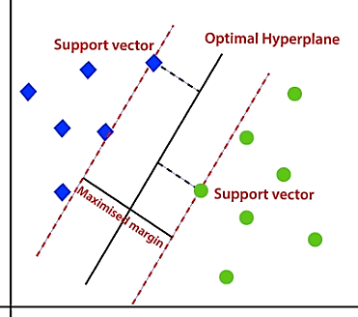
Basic terms in svm
Hyperplane
A decision boundary that separates data points into different classes.
Support Vectors
Support vectors are the data points that lie closest to the hyperplane.
These points are crucial because they define the margin around the hyperplane.
SVM algorithm focuses on maximizing the distance between the hyperplane and these support vectors.
Margin
The distance between the hyperplane and support vectors.
Maximum Margin
The distance between support vectors

Slide 8
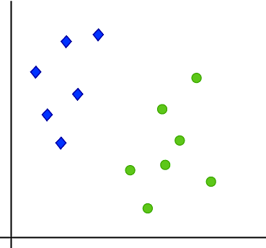
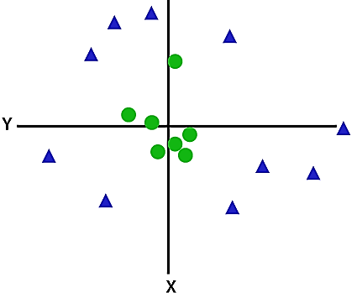
Types of svm
Linear SVM:
Linear SVM is used for linearly separable data.
If a dataset can be classified into two classes by using a single straight line.
such data is termed as linearly separable data, and classifier is used called as Linear SVM
Non-linear SVM:
Non-Linear SVM is used for non-linearly separated data
if a dataset cannot be classified by using a straight line
such data is termed as non-linear data and classifier used is called as Non-linear SVM.

Slide 9
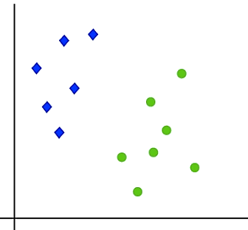
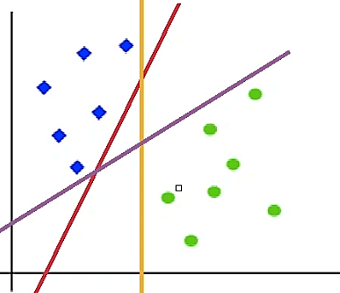
How linear svm works
Let’s understand the working of SVM using an example
Suppose we have a dataset that has two classes (green and blue)
We want to classify that the new data point as either blue or green
To classify these points, we can have many decision boundaries
The question is which one is the best and how do we find it?
The best hyperplane is that has the maximum distance from both the classes

Slide 10
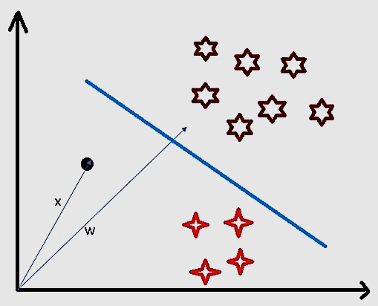
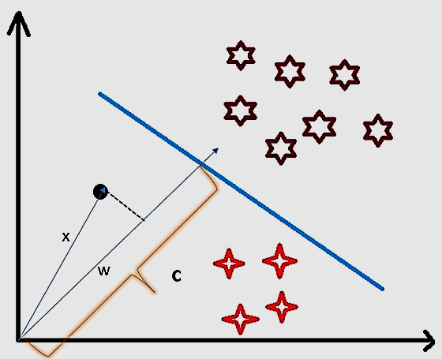
How svm classifies a new sample
Consider a random point X and we want to know whether it lies on the right side of the hyperplane or the left side of the plane.
To find this first we assume this point is a vector (X).
Then we make a vector (w) which is perpendicular to the hyperplane.
Let’s say the distance of vector w from origin to decision boundary is ‘c’.
Now we take the projection of X vector on w.
We take the dot product of x and w vectors.

Slide 11
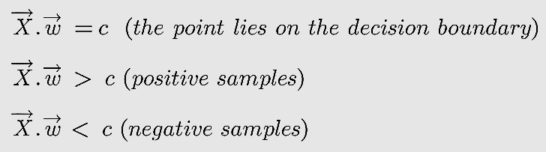
If the dot product is greater than ‘c’ then we can say that the point lies on the right side.
If the dot product is less than ‘c’ then the point is on the left side
if the dot product is equal to ‘c’ then the point lies on the decision boundary.

Slide 12
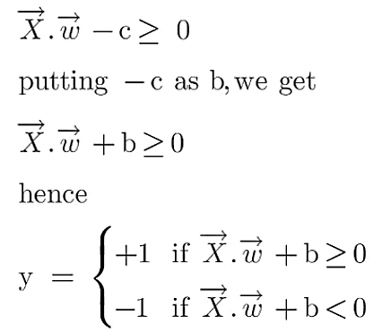
A hyperplane is w.x+b=0 where w is a vector normal to hyperplane and b is an offset/bias (distance of the hyperplane from the origin along the normal vector w).
w is the normal vector (perpendicular) to the hyperplane
x is the input vector (point in space)
b is the offset or bias term
To classify a point as negative or positive we need to define a decision rule. We can define decision rule as:

Slide 13
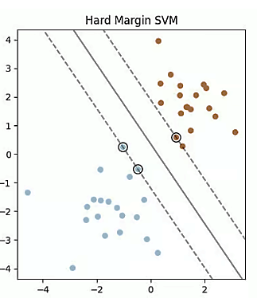
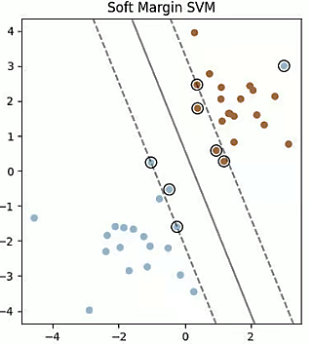
Hard Margin
A hyperplane that properly separates the data points of different categories without any misclassifications.
Soft Margin
When the data is not perfectly separable.
SVM permits a soft margin technique.
SVM softens the strict margin requirement and permits certain misclassifications or violations.

Slide 14
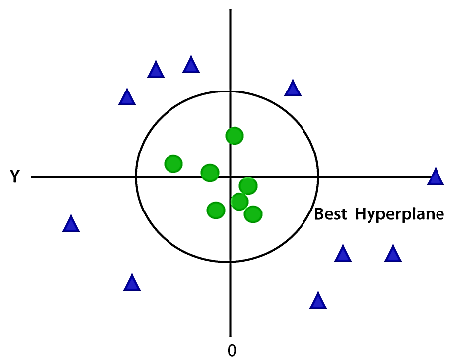
How non-linear svm works
Non-linear data, cannot be separated by a single straight line.
Non-linear SVM classifies non-linear data by transforming to high dimensional space (2D to 3D or higher according to the problem)
This transformation is performed by kernel functions.

Slide 15
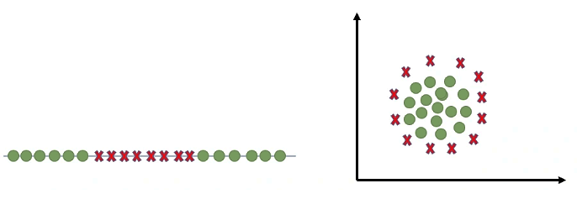
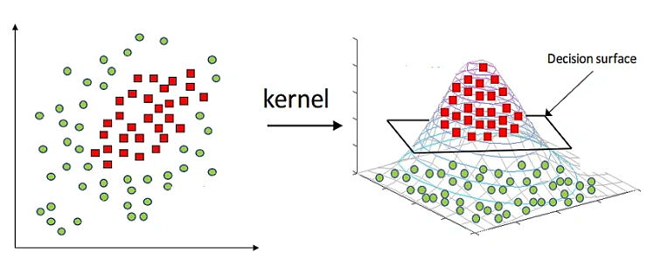
Kernel Function
Linear (used for linear classification)
Radial Basis Function (RBF)
Sigmoid
Polynomial

Slide 16
hyperparameters
Parameters that are not learned from the data but are set before training an SVM model.
They control the behavior of the model and can significantly impact its performance.
SVM hyperparameters are: (1) Kernel Function (2) Regularization (c) and (3) Gamma (γ).
(1) Kernel Function
Transform the data to higher dimensional space
(2) Regularization (C)
A small C allows the margin to be wider, even if it means more misclassified points, whereas a large C aims to classify all training points correctly but risks overfitting
(3) Gamma (γ)
A small gamma means the model has a large influence area, making the decision boundary smoother, while a large gamma means the model will be more sensitive to individual data points, potentially leading to overfitting.

Slide 17
Choosing the Right Hyperparameters
The optimal hyperparameters for an SVM model depend on the specific dataset and problem
Common techniques for selecting hyperparameters include:
Grid Search: Manually specifying a grid of hyperparameter values and evaluating the model's performance for each combination.
Random Search: Randomly sampling hyperparameter values and evaluating the model's performance.
Common problems during model training
Overfitting
Occurs when a model is too complex and fits the training data too closely
Capturing not just the underlying pattern but also the noise
The model performs well on the training data but fails to generalize to new, unseen/testing data
Underfitting
Occurs when a model is too simple and cannot capture the underlying patterns in the data.
It performs poorly on both the training data and new data because it has not learned the relationship well enough.

Slide 18
Pros and Cons of SVM
Pros:
Effective for both linear and non-linear classification: SVM can handle both linearly separable and non-linearly separable data using kernel functions.
Works well with high-dimensional data: SVM can effectively handle data with many features.
Can handle both binary and multi-class classification: SVM can be extended to handle multi-class classification problems.
Cons:
Computationally expensive: SVM can be computationally expensive for large datasets, especially when using kernel functions.
Choosing the right kernel function: Selecting the appropriate kernel function can be challenging and requires domain knowledge or experimentation.
Sensitive to the scale of features: The performance of SVM can be affected by the scale of the features. Normalization or standardization can help mitigate this issue.

Slide 19

SVR implementation in python

Slide 20
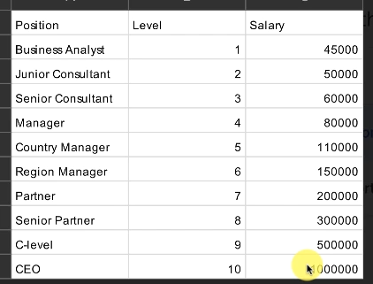
Problem at hand
SVR model will be a little advanced as compared to the models we have already used
Feature scaling and inverse feature scaling will be used extensively
The old dataset ‘Position_Salaries.csv’ and old problem of salary will be used

Slide 21
Steps for python implementation
1. Importing the libraries and dataset
2. Feature scaling (Since in SVR we have an implicit relationship equation between independent and dependent variables, so we need to apply feature scaling. For SLR, MLR and polynomial regression we have an explicit relationship and we do not use feature scaling.)
3. Training the SVR dataset on the whole dataset
4. Predicting a new result
5. Visualizing the SVR results
6. Visualizing the SVR results for higher resolution and smoother curve

Slide 22
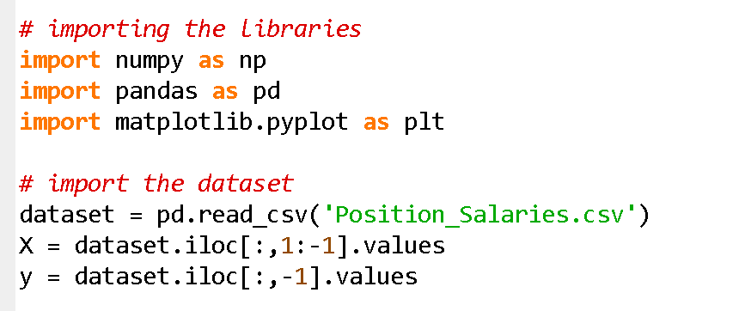
Importing the libraries and dataset

Slide 23

We need to scale the independent variables as well as the dependent variable because the values for salaries are too high as compared to the position level.
We will apply standard scaler to both the columns separately.
But first, we need to reshape y, since the scaler function needs input arguments which are a 2D array.

Slide 24
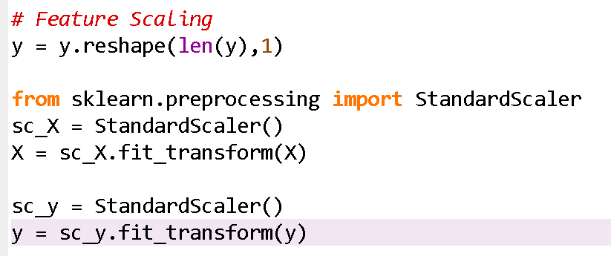
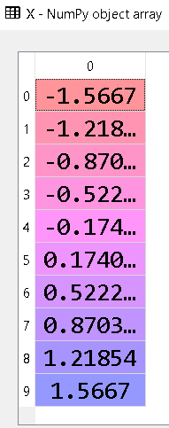
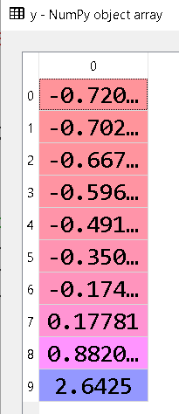
Feature scaling

Slide 25

SVM Parameters
Kernel
SVM algorithms use a set of mathematical functions that are defined as the kernel.
Kernel in the SVM is responsible for transforming the input data into the required format.
Some of the kernels used in SVM are
Linear
polynomial
radial basis function (RBF).
For creating a non-linear hyperplane, we use RBF and Polynomial function.

Slide 26
Regularization (C)
We can maintain regularization by adjusting it in the Scikit-learn’s C parameters.
C denotes a penalty parameter representing an error or any form of misclassification.
With this misclassification, one can understand how much of the error is actually bearable.
With a smaller C value, we obtain hyperplane of small margin and with a larger C value, we obtain hyperplane of larger value.

Slide 27
Gamma
With a lower value of Gamma will create a loose fit of the training dataset.
A high value of gamma will allow the model to get fit more appropriately.
A low value of gamma only provides consideration to the nearby points for the calculation of a separate plane whereas the high value of gamma will consider all the data-points to calculate the final separation line.

Slide 28
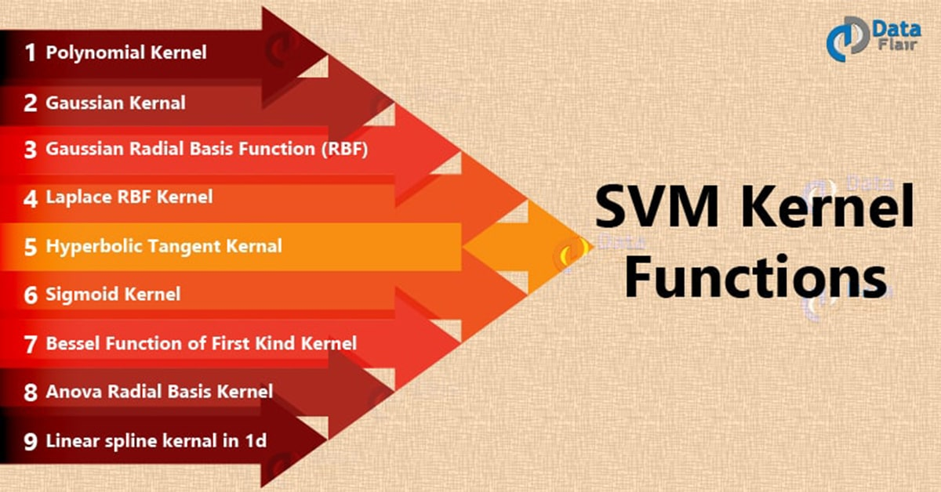
https://data-flair.training/blogs/svm-kernel-functions/
We will be using the Gaussian RBF kernel function
https://data-flair.training/blogs/svm-support-vector-machine-tutorial/

Slide 29
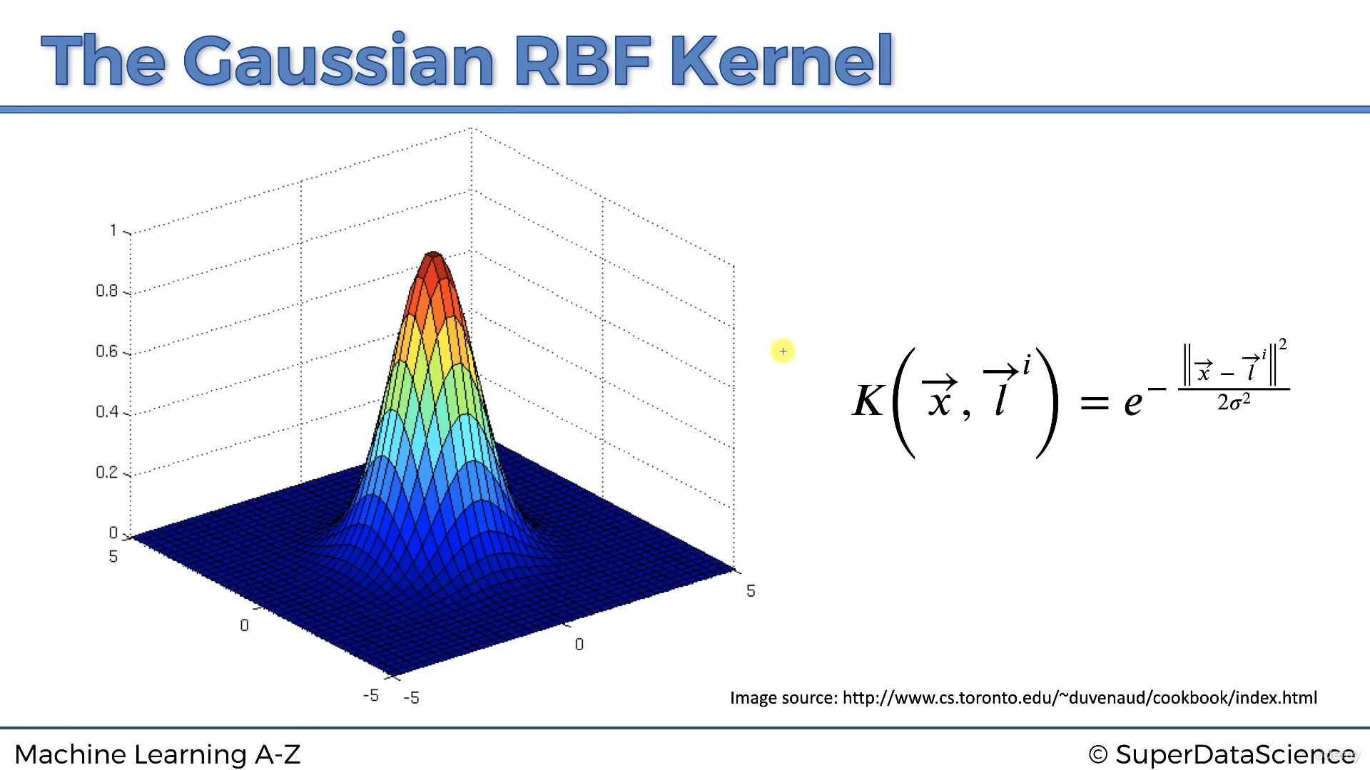

Slide 30
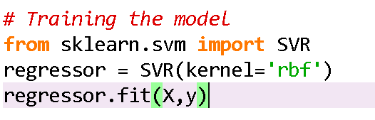
Training the model
Kernel used is Gaussian RBF
Congratulations you have trained your first SVR model !!!

Slide 31
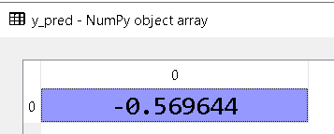
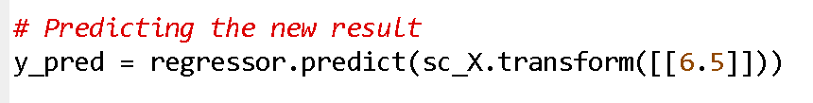
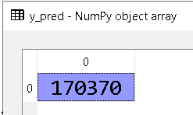
Predicting the new value
We usually put [[6.5]] as the input
But the SVR model was trained using the scaled versions of X and y
We will use sc_X and use transform method to scale the input
This is a scaled predicted value
Now we need to perform inverse scaling
This is the inverse scaled value
Congratulations!!!
You have predicted the Salary and now you can handle transformations as well as inverse transformations
The predicted salary is close to the asking salary
Hence, SVR is well adapted to this dataset

Slide 32
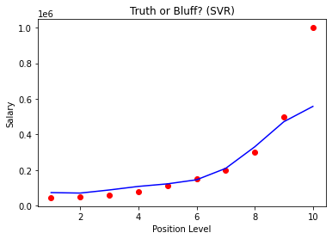
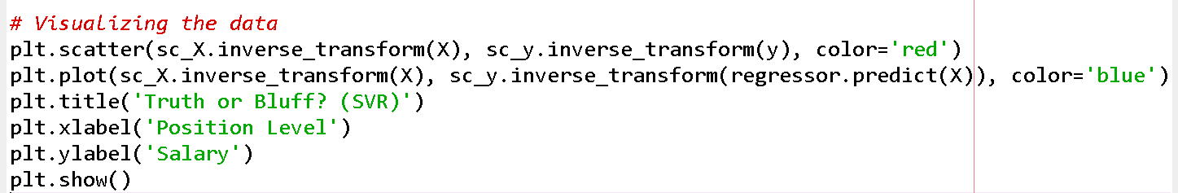
Visualizing the results

Slide 33
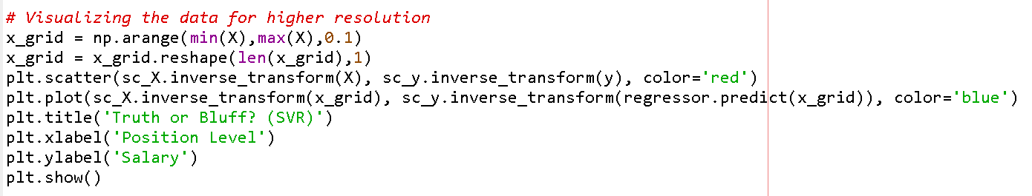
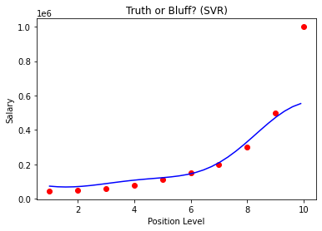
Visualizing the results for higher resolution and smoother curve
The SVR caters for outliers as shown in the curve

Slide 34
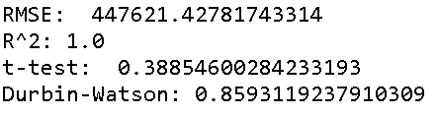
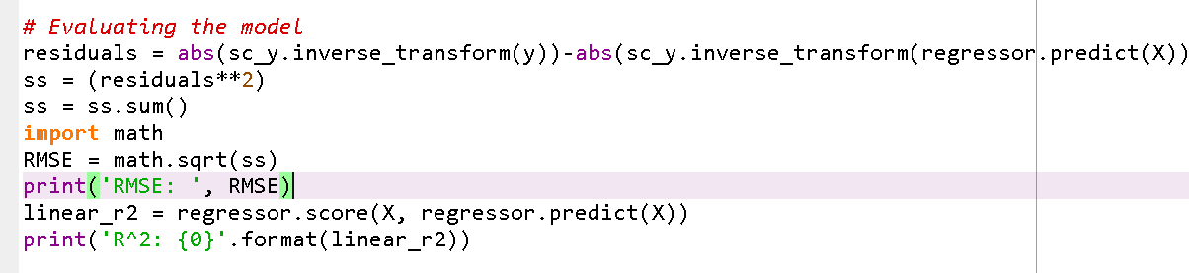
Evaluating the model

Slide 35
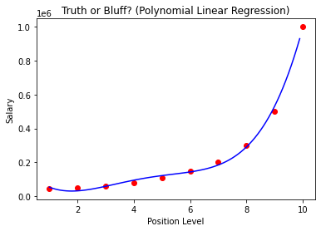
Comparison between polynomial and SVM regression
In the case of polynomial regression there seems to be some amount of overfitting, which is not the case for SVR
SVR usually performs good for linear as well as the non-linear datasets

Slide 36
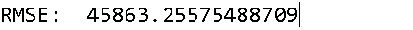
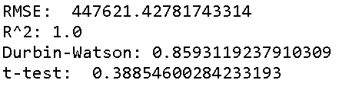
Comparison between polynomial and SVM regression
Polynomial regression
SVR

Slide 37
Advantages of SVM
Guaranteed Optimality:
The solution will always be global minimum not a local minimum.
Abundance of Implementations:
We can access it conveniently, be it from Python or Matlab.
SVM can be used for linearly separable as well as non-linearly separable data.
Kernels help SVM to carry out the feature mapping using simple dot product, which reduces the computational expense

Slide 38
Disadvantages of SVM
SVM is incapable of handling text structures. This leads to loss of sequential information and thereby, leading to worse performance.
SVM cannot return the probabilistic confidence value that is similar to logistic regression. This does not provide much explanation as confidence of prediction is important in several applications.
Choice of the kernel is perhaps the biggest limitation of the support vector machine. Considering so many kernels present, it becomes difficult to choose the right one for the data.

Slide 39

Any Questions

